Slide 1
CS 498 VR
VR
Design & Development
Methodologies
(For internal use only)

Slide 2


Who am I?
35 years in the video game industry
Self taught programmer
Designed, programmed & shipped 2 games
Spent 11 years doing external development
Taught me communication and information gathering
Basically a production guy with input on design
Game development from all sides
Last 15 years I was responsible for Volition game Dev.
Experimented with various structures/methodologies

Slide 3
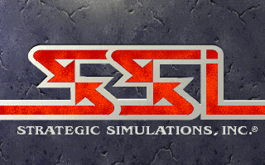

My 30 Game Industry Career is a sine wave
SSI: Developer and Publisher - PROS Amazing people
The golden age, worked on every kind of game imaginable Produced lots of games in every genre from Eports, RTS, RPG, Wargame, & shooters
Learned production processes
Filled about every position in the hierarchy
SSI: Developer and Publisher - CONS Did external production primary, missed some of the team management processes
The company was privately owned, couldn’t sustain
Had to sell (3 times) and each new buyer was an adventure in ineptitude
Went through a layoff

Slide 4


My 30 Game Industry Career is a sine wave
EA: Westwood – PROS
Great group of people, very professional Interfaced with EA Studio Execs daily Learned a lot of high level elements
Got to meet some amazing designers
EA: Westwood – CONS
EA Studio Management was broken: politics & BS. Studio had an odd culture of secrecy, & mistrust
Studio direction was off…

Slide 5

My 30 Game Industry Career is a sine wave
Volition: - PROS Latitude to set structure and process
Really smart, amazing teams Great culture
Saw some success, SR3 hit 6million
Location meant that corp stayed away
Volition: - CONS 2 Games in cycle, 1 set wasn’t a hit
Stockholders mean time constraints
Location made it tough to hire
Bankruptcy
To be AAA (high end), you need big bucks

Slide 6
CS 498 VR Goals and Expectations
General
Set up the project teams as soon as possible
VR History
Develop the key elements of the projects
Initial idea
Project Plan
High & Mid-level design
Simple production documents
Discuss VR (design elements, key considerations)
Present a survey of the video game industry, studios and projects
Go into a bit more detail about the Design and Production processes
Complete the projects via a simplified project plan

Slide 7

History of VR
1838: Stereoscopic Vision – Invented by Charles Wheatstone, it brought depth to photography via a viewer and special slides

Slide 8
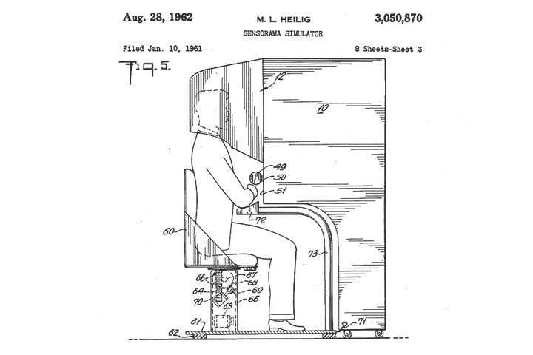
History of VR
1952: Sensorama - Morton Heilig created a device to address all sensory input, it included stereoscopic 3D display, fans, smell generators, stereo speakers and a vibrating chair. He built working models in 1956 and made several movies for the device.

Slide 9
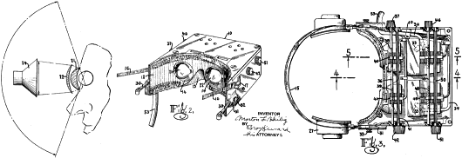
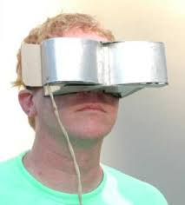
History of VR
1960: Telesphere Mask – Heilig followed up with what is considered to be the first HMD. It featured stereo 3D as well as wide vision and stereophonic sound.

Slide 10
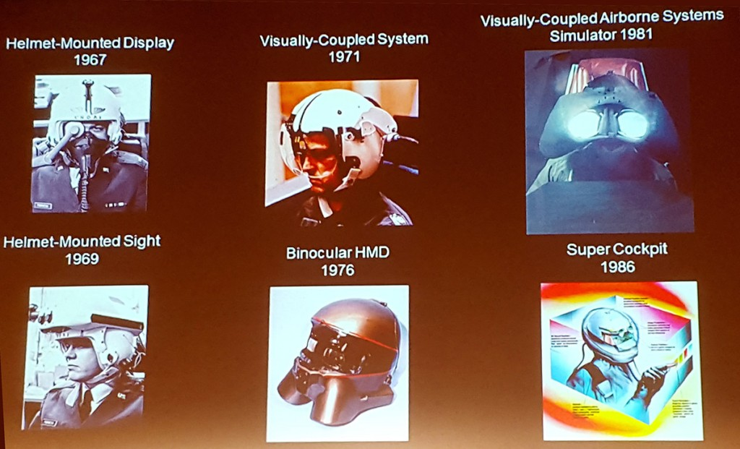
History of VR
1960s: Super Cockpit Program – Tom Furness, working in the Air Force, created some of the first HMDs. He worked on fully immersive cockpit simulations for 20 years before leaving and working at he forefront of VR at the U. of Washington.
He created Human Interface Technology Lab and the Virtual World Society to drive VR in the educational realm.

Slide 11
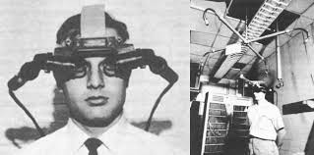
History of VR
1961: Headsight – Developed by Comeau and Bryan,engineers from the Philco Corporation) engineers (Comeau & Bryan) developed the first precursor to the HMD as we know it today – the Headsight. Each eye had a video screen and there was a motion tracking device that linked to a remote camera, moving your head moved the camera. Headsight was the beginning of modern HMD but it lacked computer integration and with that, computer generated images.

Slide 12
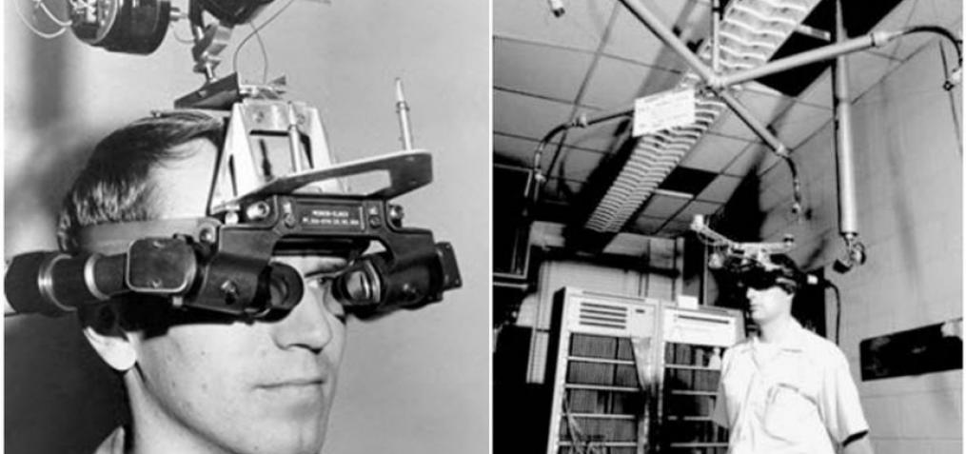
History of VR
1965: Ivan Sutherland, MIT scientist, described the “Ultimate Display” concept, a description of Virtual Reality that became a blueprint for what modern VR became.
1968: Sword of Damocles project – Sutherland created the first VR HMD attached to a computer. It was tethered to a telescoping arm that hung over the user, hence the name, collecting data on head tracking while simple geometric shapes were shown via a stereoscopic display.
https://vrroom.buzz

Slide 13
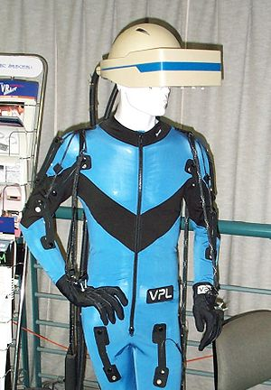
History of VR: VPL Research
1987: - The term Virtual Reality is popularized by Jaron Lanier and the he went on to create VPL Research which built various items in support of VR including :
the DataGlove (a major development in VR haptics)
the Datasuit
Eyephone (HMD)

Slide 14
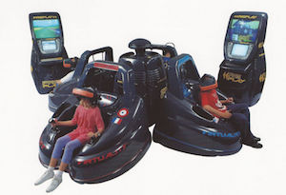

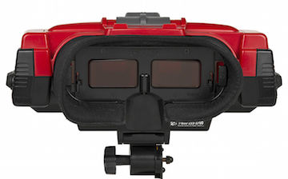
History of VR
1990s: VR Goes Mainstream
1991: Virtuality Group
launched a range of VR arcade games and machines
1993: Sega VR (never Shipped)
1995: Nintendo Virtual Boy

Slide 15
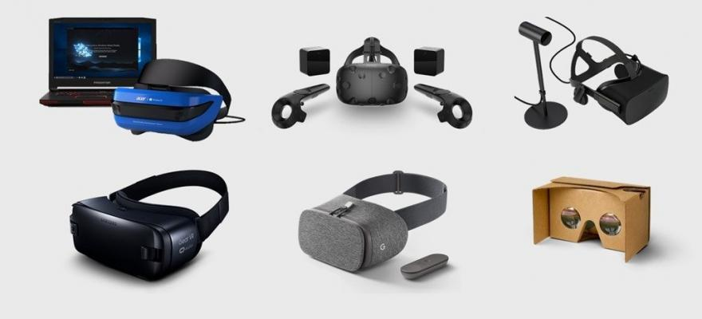
History of VR
2010: 18-year-old entrepreneur Palmer Luckey created a prototype for the modern VR systems called the Oculus Rift. He raised over $2M in a Kickstarter and created huge consumer and corporate interest in Virtual Reality, resulting in the sale of his company to Facebook for $2B in 2014.
2015-2016: Various VR systems shipped
Oculus Rift
HTC Vive (in conjunction with Valve)
Samsung Gear
Playstation VR
Google Cardboard

Slide 16
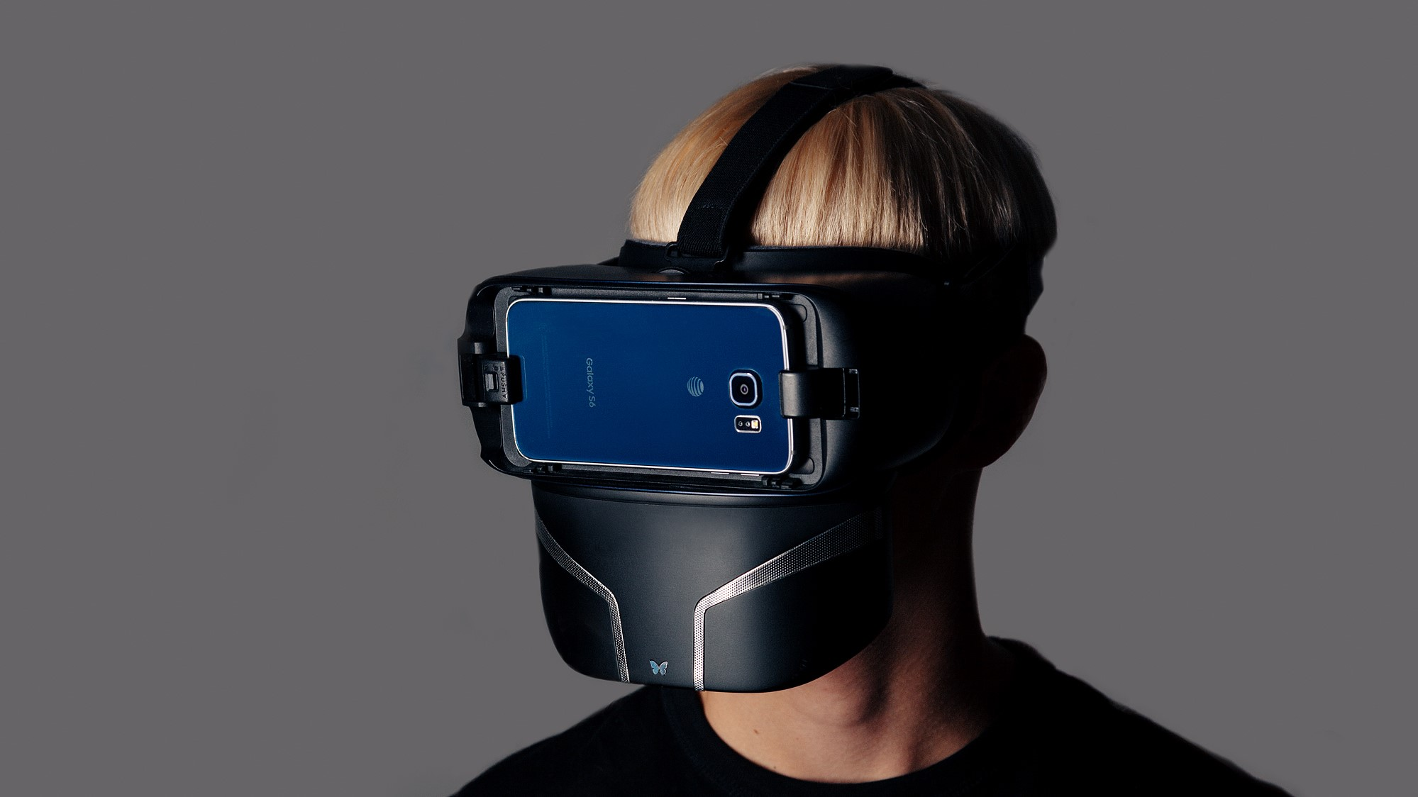
History of VR
2019: Feelreal - Modern version of the original Sensorama, Feelreal is a new company producing a VR mask add-on that provides olfactory, water, hear, wind and vibration feedback for the current VR masks.
Feelreal.com

Slide 17
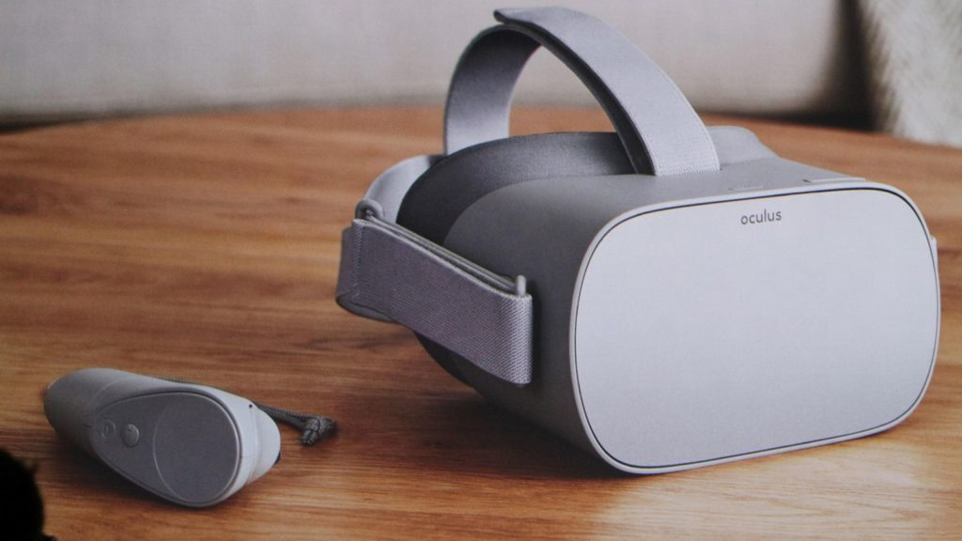
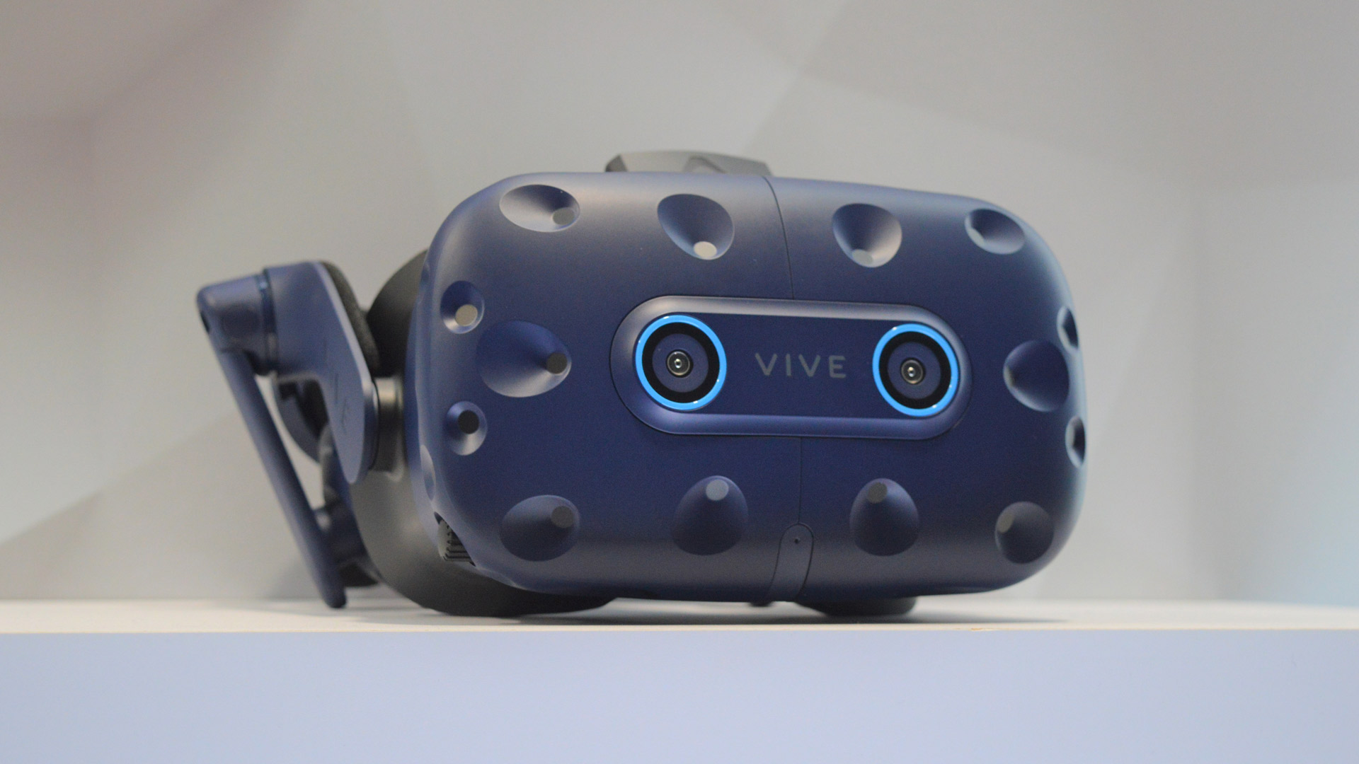
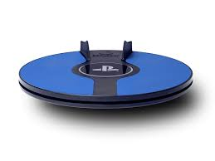
History of VR
2019: Oculus GO, HTC Vibe Pro with Eye tracking, Foot Controller - 3DRudder
“VR for the masses”
Untethered
No External position sensors
Low price point
Features
Foveated rendering
“gaze-oriented menu navigation"
Features
Removes teleporting
Reduces motion sickness

Slide 18
CS 498 VR
VR
Design & Development
Methodologies
(For internal use only)

Slide 19

Principles of Design: Starting Points
All apps/games start with an IDEA
There is so much more to what you want to build
The primary role of a designer is to clearly communicate how that IDEA fits into an App/Game (the bigger picture, the Vision)
What happens without that clarity?
Confusion
Delay
People building to their own vs. the required standards
The question is: what focuses the design, what drives the definition of the Vision?

Slide 20
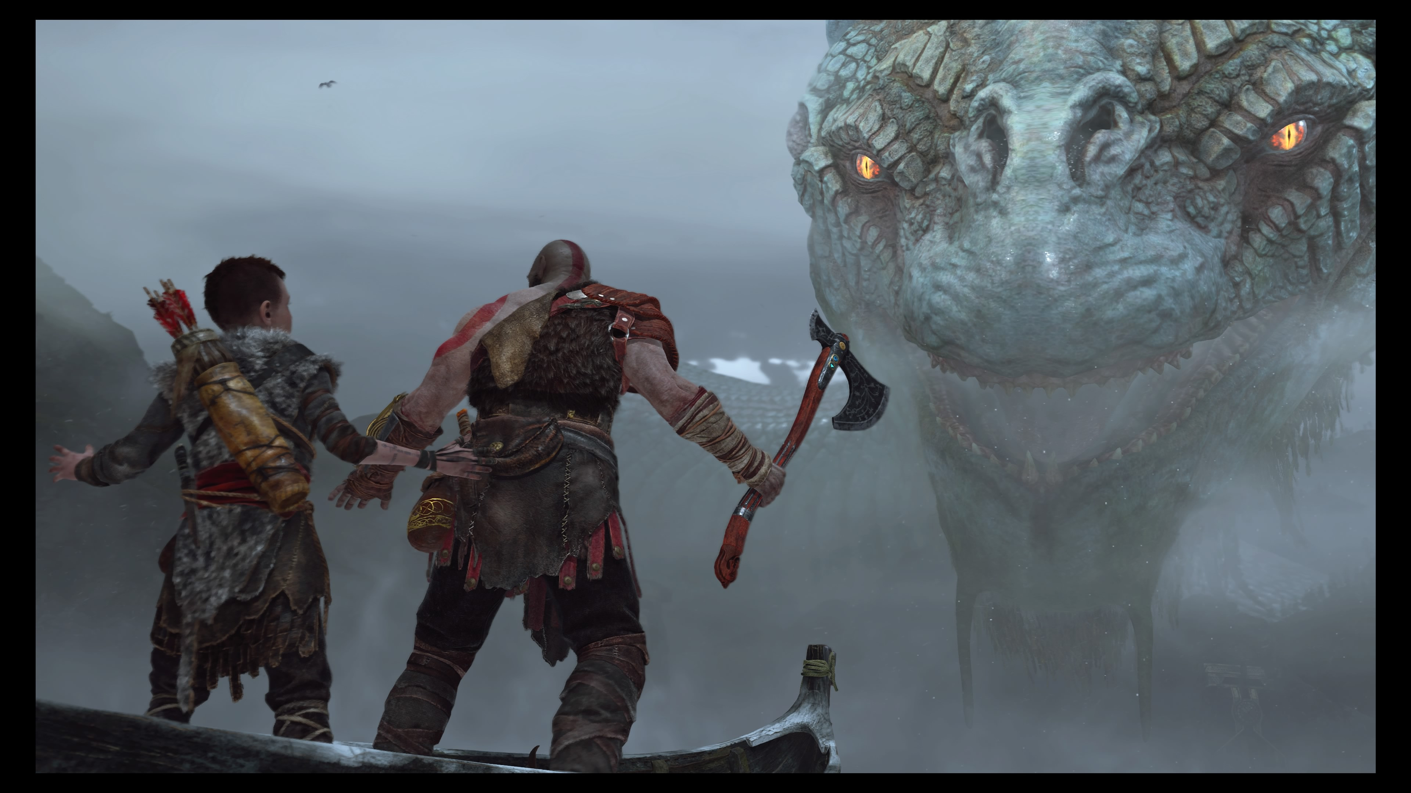
Principles of Game Design: Starting Points
User Experience(s): The different emotional responses we are trying to elicit with our app/game features
Example: We want the gamer to be in awe when they face the challenges of our world.

Slide 21
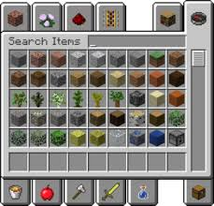
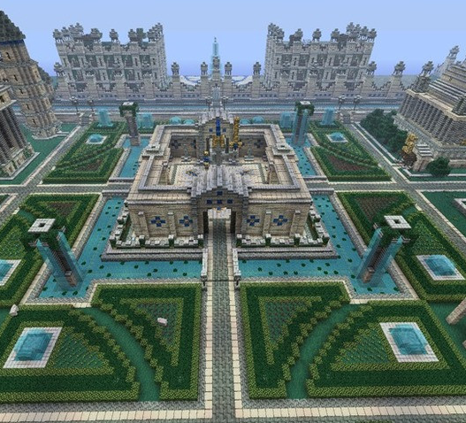
Principles of Game Design: Starting Points
User Types: These define the core interests of the user we are targeting with our features.
Example: Minecraft
The Collector:
This user requires the opportunity to gather items and build a large stockpile of items.
The Builder:
This user type enjoys creating different imaginative items from the resources available.

Slide 22
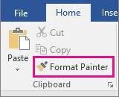


Principles of Design: General
Design from the user’s perspective, their experience:
What are they seeing, thinking and FEELING as they move through your app/game?
Fulfill the user’s low level expectations, make them feel comfortable
Think about the difference between Microsoft Word & Google Docs Format Painter
Make the user’s path or choices clear and meaningfulayers want to be successful (remember to avoid punishing failure)

Slide 23
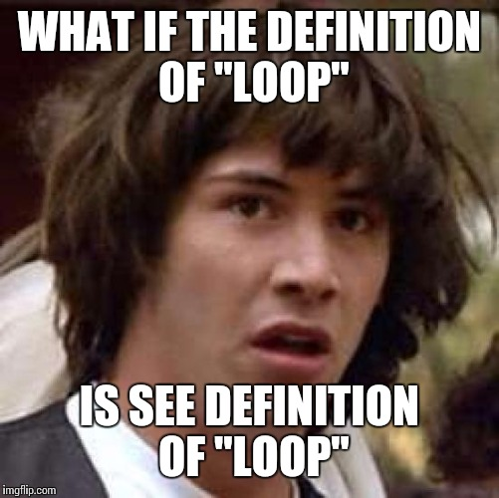
Principles of Game Design: General
Determine your constraints. Constraints lead to better designs.
Remember: Everything you design should be a loop

Slide 24

Principles of Game Design: General
Immersion
We will talk quite a bit more about this, VR has a different set of issues in this area
Absence is the enemy
When something is missing it is stands out

Slide 25
Principles of Design: For Games
REMEMBER to Iterate to fun
Don’t trust your view of fun
Get audiences of people that fit your player types to test your game
When they tell you its fun you have something

Slide 26
The Top Down Design Process
We are going to put you on a team
Your team will decide on a design idea which you will submit
Your team will Figure out your audience and then create a High level Vision Canvas
User Experience
User Types
Do a mid-level breakdown of the design leading to a strong list of features
Game Loop: Mid level action flow (still fairly general) showing how the app/game works
Beat by Beat: Narrative walk through of the actions/play used
Create a prioritized list of the features/systems in your app/game
This will give you the elements you need to start building your project plan

Slide 27
Vision Canvas
The layout is important
App/Game Name
Descriptive
Genre
World
Inspirations
Targets
User Experience
User Types
Foundational
Core Pillars
Core Systems
High Level Vision Canvas
App/Game Name
Inspirations (note what it is inspiring) | Genre (ex: RPG, Travel) | Core Pillars (in the form "Player can...") | Core Systems (ex: Save/Load or Combat) | User Experience (the emotion elicited)
 | IP/World (ex: Sci-fi, Beach)
 |  |  |  | Player Types (rank by priority)

Slide 28

Considering/Describing the Audience
Design requires consideration for an audience
Designers often design for an audience of 1
Platforms help define the audience
Mobile, iOS
Console/PC
The style provides another level
First person/3rd/God game (real time/turn based)
Non-game apps have methods/styles users expect
Genre can constrain it even more
RPG, Open World, Shooter, Platformer, etc.
Spreadsheet, Written Doc, Travelogue, etc.
Of course it all blends somewhat but people have preferences
And you can go even lower (we defined our own)
In games we use: rule breaker, grinder, collaborator, customizer
Define them any way you want but be consistent and make sure the team understands the target.
You Suck

Slide 29
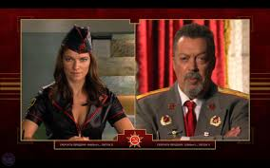
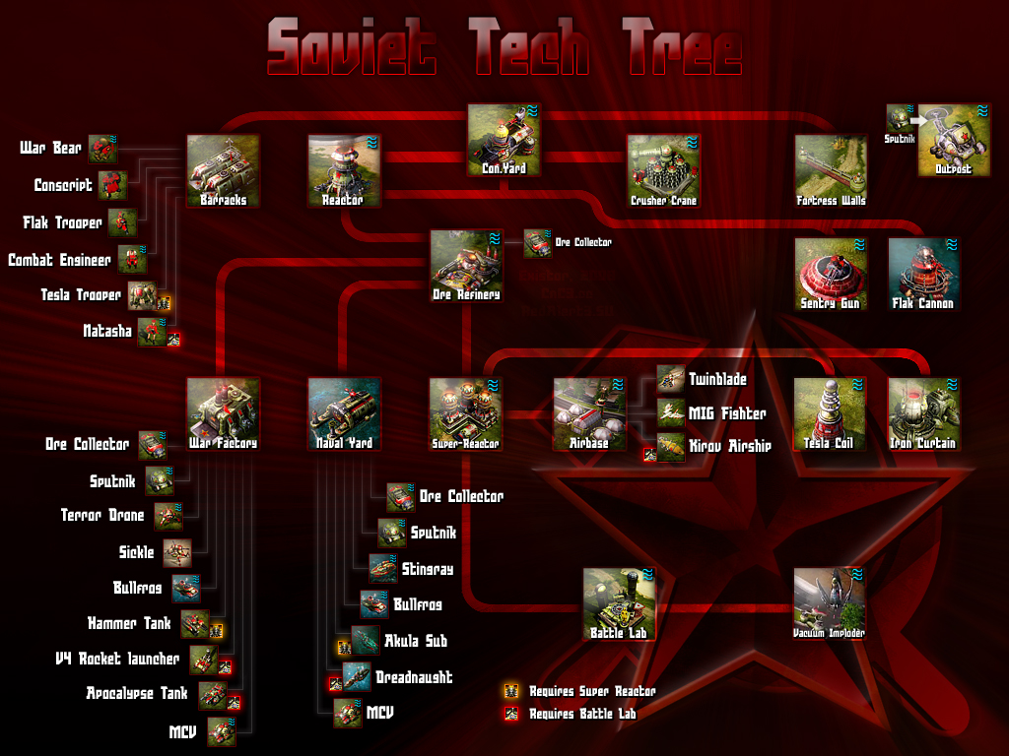
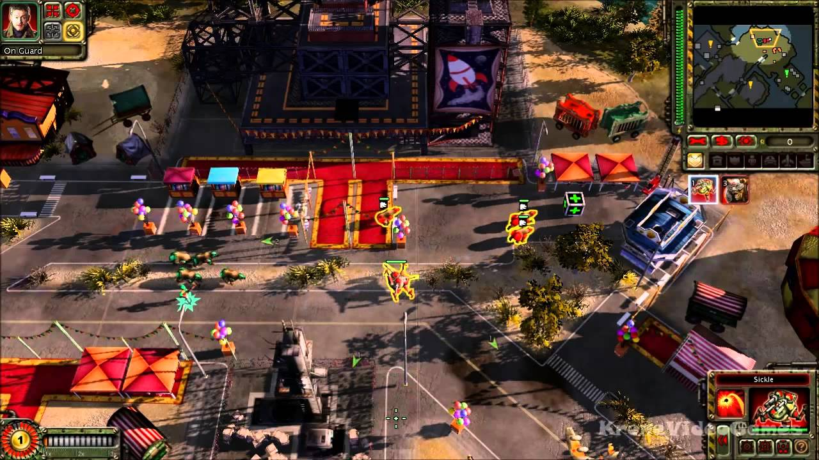
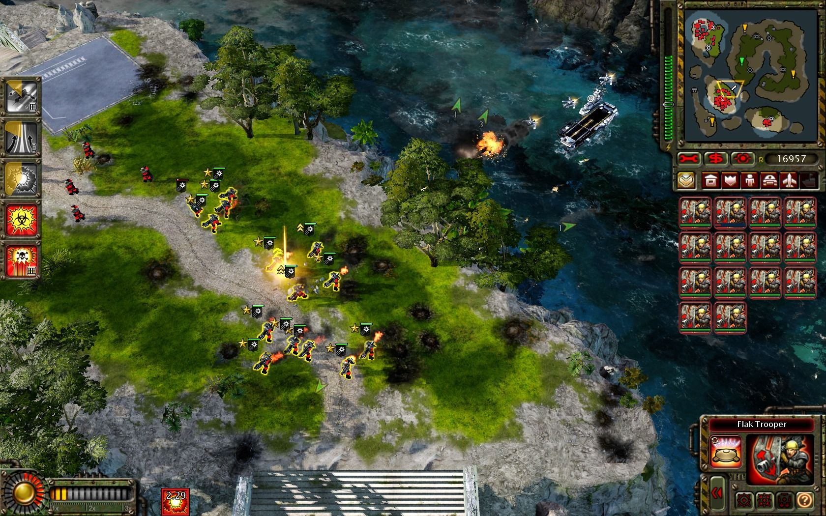
Vision Canvas: App/Game Specifics
Core Pillars
High Level elements that drive the Player Experience (Red Alert 2, Westwood)
The user will …..
Core Systems
Systems that support key actions in the app/game
Points to key low level systems
Examples: Navigation, Melee combat, etc.

Slide 30
Design Docs Process: Simple Action Loop
Win/Lose, no repeat
Lose, repeat
Start
S01
Home Base
S02
Mission
S03
Combat
S04
Death

Slide 31
CS 498
Virtual Reality
Design Processes
Jan 28th
(For internal use only)

Slide 32
CS 498 VR Design Elements
Design Phase (Discovery) is coming up
Starts with Team creation
Survey should go out end of this week
Teams should be built the week after
Concept proposal will be due a week after team formation
Discovery documents will be due Feb. 22th
Discovery Docs include
High Level Vision Canvas
Action Loop or Loops
Feature List
Team Milestone plans for Pre-Production (2 weeks, ending March 8th)

Slide 33
Vision Canvas
The layout is important
App/Game Name
Descriptive
Genre
World
Inspirations
Targets
User Experience
User Types
Foundational
Core Pillars
Core Systems
High Level Vision Canvas
App/Game Name
Inspirations (note what it is inspiring) | Genre (ex: RPG, Travel) | Core Pillars (in the form "Player can...") | Core Systems (ex: Save/Load or Combat) | User Experience (the emotion elicited)
 | IP/World (ex: Sci-fi, Beach)
 |  |  |  | Player Types (rank by priority)

Slide 34
Design Docs Process: Simple Action Loop
Win/Lose, no repeat
Lose, repeat
Start
S01
Home Base
S02
Mission
S03
Combat
S04
Death

Slide 35
Vision Canvas – Single Project/Level Version
Process for Completion:
Come up with an IDEA
High Level Vision Canvas
App/Game Name
Inspirations (note what it is inspiring) | Genre (ex: RPG, Travel) | Core Pillars (in the form “User can...") | Core Systems (ex: Save/Load, Combat) | User Experience (the emotion elicited)
 | IP/World (ex: Sci-fi, Beach)
 |  |  |  | User Types (rank by priority)

Slide 36
Vision Canvas – Single Project/Level Version
Determine the Descriptors
Define the Genre
1st Person or 3rd, Travelogue, Shooter
Don’t include info about the world
Expectation is for standard Genre vernacular
Describe the World/Environment or IP
Information about the background of the world
Post Apocalyptic, Sci Fi, Japan, Beach , etc.
Licensed Intellectual Properties, etc.
Concepts
Narrative
These define the context, interactions and connections. They describe how the user interacts (ex: camera view) and relates (especially for a existing IP).
High Level Vision Canvas
App/Game Name
Inspirations (note what it is inspiring) | Genre (ex: RPG, Travel) | Core Pillars (in the form “User can...") | Core Systems (ex: Save/Load, Combat) | User Experience (the emotion elicited)
 | IP/World (ex: Sci-fi, Beach)
 |  |  |  | User Types (rank by priority)

Slide 37
Vision Canvas – Single Project/Level Version
Descriptors, continued:
Write down all your inspirations
Get specific
UI
Game play features
Tone (Tone Targets)
Style (Graphic look)
Lighting
This helps define the emotional elements the user will be experiencing.
High Level Vision Canvas
App/Game Name
Inspirations (note what it is inspiring) | Genre (ex: RPG, Travel) | Core Pillars (in the form “User can...") | Core Systems (ex: Save/Load, Combat) | User Experience (the emotion elicited)
 | IP/World (ex: Sci-fi, Beach)
 |  |  |  | User Types (rank by priority)

Slide 38
Vision Canvas – Single Project/Level Version
Target Information
User Experience
The emotional experience the user is having
Should relate to core pillars
Player Types
Self defined
Should be descriptive
Should represent the key users
In descending order
Don’t go too broad
Make up your own descriptors
High Level Vision Canvas
App/Game Name
Inspirations (note what it is inspiring) | Genre (ex: RPG, Travel) | Core Pillars (in the form “User can...") | Core Systems (ex: Save/Load, Combat) | User Experience (the emotion elicited)
 | IP/World (ex: Sci-fi, Beach)
 |  |  |  | User Types (rank by priority)

Slide 39
Vision Canvas – Single Project/Level Version
Foundational Elements
Core Pillars
Features that drive the User Experience
In the form: “The User will …..”
Core Gameplay Systems
Systems that support the core pillars and other key aspects of the app/game
Points to key low level systems
Examples: Traversal, UI, AI (if needed).
High Level Vision Canvas
App/Game Name
Inspirations (note what it is inspiring) | Genre (ex: RPG, Travel) | Core Pillars (in the form “User can...") | Core Systems (ex: Save/Load, Combat) | User Experience (the emotion elicited)
 | IP/World (ex: Sci-fi, Beach)
 |  |  |  | User Types (rank by priority)

Slide 40
VR Design: General Concerns
Platforms
Numbers (end of 2017)
Samsung Gear: 8.2M
PSVR: 2.4M
Oculus Rift: 570K
HTC Vive: 720K
The platform you develop for has impact on the product
Sales usually means going for the broadest market which can impact key elements
User interface
Scope (memory limitations as well as user comfort)
Graphics
Content volume (cost related)

Slide 41
VR Design: General Concerns
Immersion vs. Presence (Michael Abrash)
Immersion is being presented with data from a false environment
Your brain/body know it is false but you suspend disbelief
Examples include Books, cinema, TV, etc.
Presence is having your body believe in the new environment on a fundamental level
The subconscious perceptual systems believe in the illusion
Hearing, proprioception, touch, etc.

Slide 42

VR Design: General Concerns
Issues with Presence
Cognitive load
Cognitive load refers to the amount of mental processing power needed to use your product.
Think of the things that a new user faces when they first enter VR
Confusion
Lack of Direction
Lack of know how

Slide 43
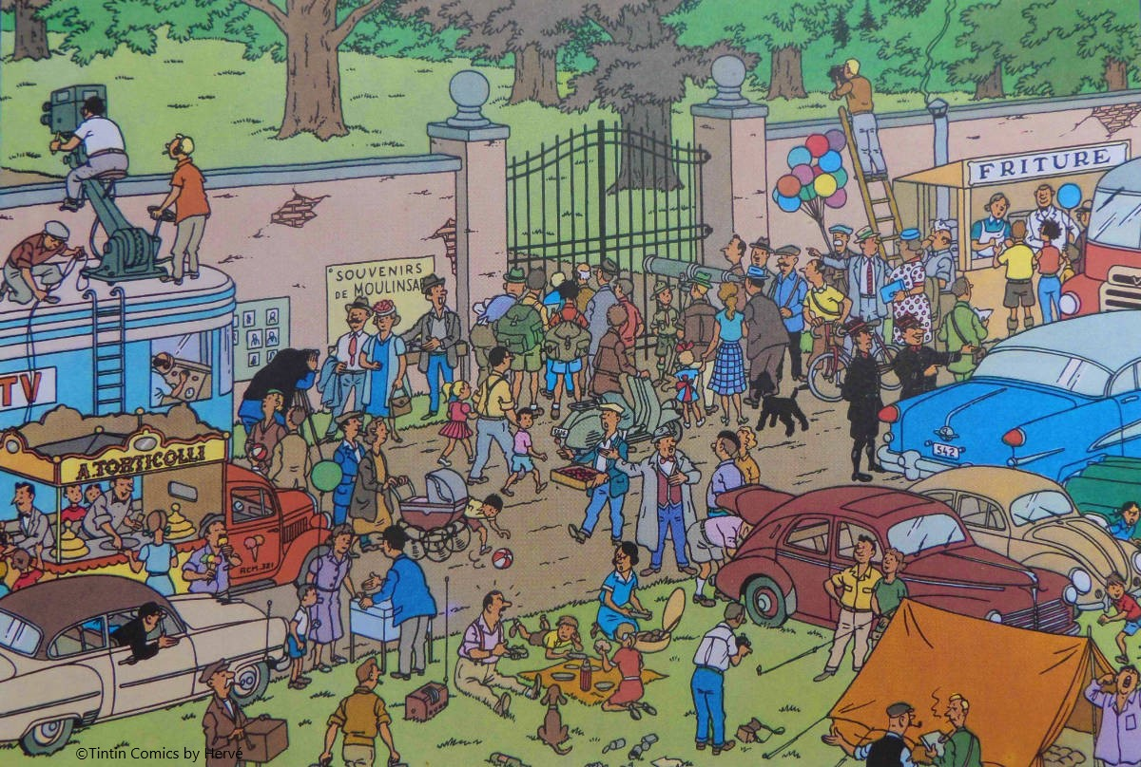
VR Design: Dealing with Cognitive Load
Cognitive load study
Simplify the scene (at least at first)
Give users control of their navigation
Driver vs. Passenger
Give the user clear directions/goals
Progress reports/hints
Avoid Depth Confusion
UI can be problematic here
Use Rest Frames if possible
Fidelity should match the Target system
Head turning on mobile

Slide 44
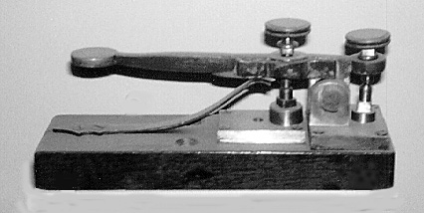
VR Design: General Concerns
Issues with Presence (cont)
Kinematic load (repetitive overload)
Kinematic load refers to the amount of physical activity needed to use your product.
Google Study on how people enjoy VR

Slide 45
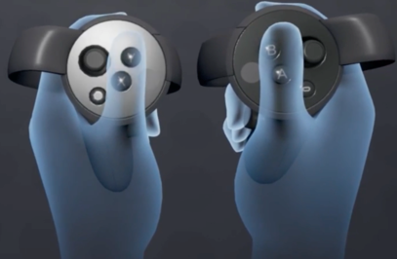
VR Design: Dealing with Kinematic Load
Limit arm, elbow and hand movement
We will speak specifics in a bit
Build simply and support high end
Oculus best practices

Slide 46

VR Design: General Concerns
Issues of Control
Users must feel they control their space
This is very important when you have walk around room sizes
Direction is paramount
Knowing what to do and how to do it gives the feeling of control
Managing choices can be an issue with less input methodologies
Error handling in interactions can be problematic
Leads to frustration and the feeling of loss of control

Slide 47
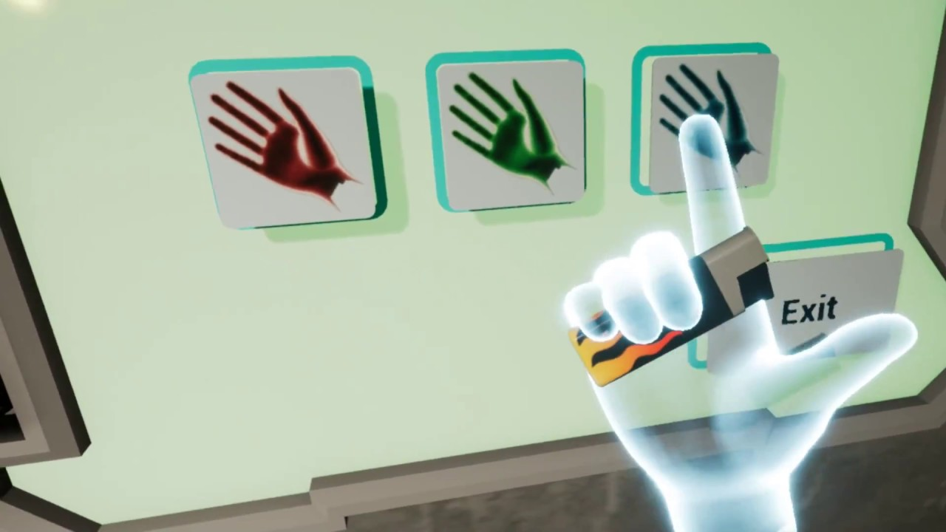
VR Design: Summary of General Concerns Yasser Malaika (Valve), Patrick O'Luanaigh (nDreams) Mike Agler (Google) , Design Best Practices (Oculus)
Presence but not full reality
Keep the user in your world but simplify the repetitive and mundane
Hand representation is key, players notice when things are wrong with game hands
Non-realistic hands
Don’t create an expectations where hands have to do more than is comfortable in VR

Slide 48
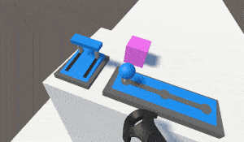
VR Design: Summary of General Concerns Yasser Malaika (Valve), Patrick O'Luanaigh (nDreams) Mike Agler (Google) , Design Best Practices (Oculus)
Don’t create objects that don’t behave as expected (handles on pots, etc.)
Make sure that objects with interactable elements are interactable
Drawers with handles should open, etc.
Real isn’t as important as ease of use an simple functionality
Watch out for simulation fatigue
Don’t make a person use big gestures to do common place things
Make any gesture a satisfying and meaningful experience

